Slide 1

Assignment A5a Low-Fidelity Paper Prototype
Team: Sports Lover Group: C12
Name: Jiachen Wan
Table of Contents 5.1 Hierarchical Task Analysis 5.2 Usability Testing Script 5.3 Low-Fidelity Paper Prototype with Facilitation & Observation notes off-side, outside Slideshow mode

Slide 2
5.1 Hierarchical Task Analysis
I will focus on the search filters and recommendation part of the badminton court app. The design of search filters is to narrow results based on users' specific criteria when selecting a badminton court. Our app also includes the most popular pitches recommendation engine to maintain user’s attention.
View recommendations of well-reviewed badminton courts. Adjust the search filter to select appropriate pitches.
- View the recommendations of well-reviewed badminton courts
- Narrow results based on users' specific criteria
- Adjust filter by distance
- Adjust filter by price
- Adjust filter by reviews

Slide 3
5.1 Hierarchical Task Analysis
I will also concentrate on the design of the ordering and payment part of our app to help users book the badminton courts more efficiently and directly.
View the main Page. Register to become a new member or sign in a personal account. Be able to update the shopping cart and make a payment to reserve the space.
View the main page
Sign up
- Update the shopping cart information
- Make a payment

Slide 4
5.2 Usability Testing Script
Scenario: You are a 3rd year computer science student. You heard from your friends that there is an app which can help you book the badminton court efficiently and directly. You decide to try it.
1. You plan to play badminton with your friends on June 30th, so you want to find a cost-effective badminton court near your living place first, how can you do to find the court using this prototype?
2. You are a new user to the app, how can create your account through this prototype?
3. You just remembered that you have a midterm coming up on July 1st, you will need to prepare for the midterm instead of playing badminton. How can you cancel the plan or change the time slots from the shopping cart?
4. You are satisfied with the plans in the shopping cart and want to make a payment to hold the space, what can you do with this prototype?

Slide 5
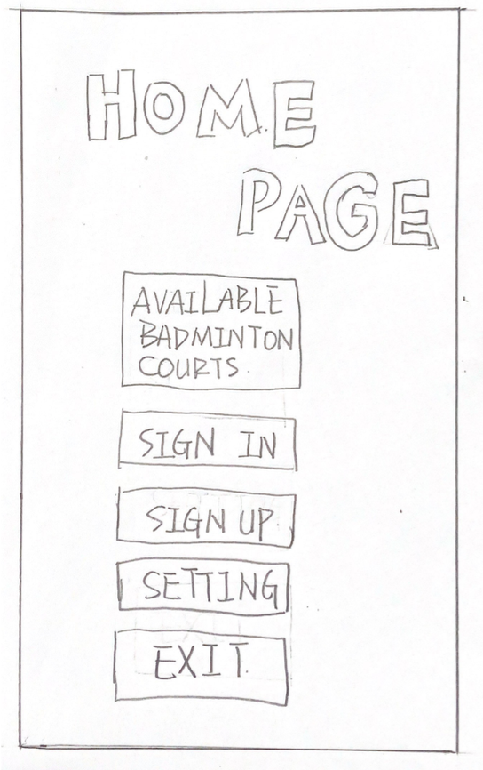
5.3 Low-Fidelity Paper Prototype
1. You plan to play badminton with your friends on June 30th, so you want to find a cost-effective badminton court near your living place first, how can you do to find the court using this prototype?
EXPECTED USER ACTION
Click [AVAILABLE BADMINTON COURTS]
OBSERVED ACTION
USER QUOTES
DESIGN IMPLICATIONS for A5b Results

Slide 6
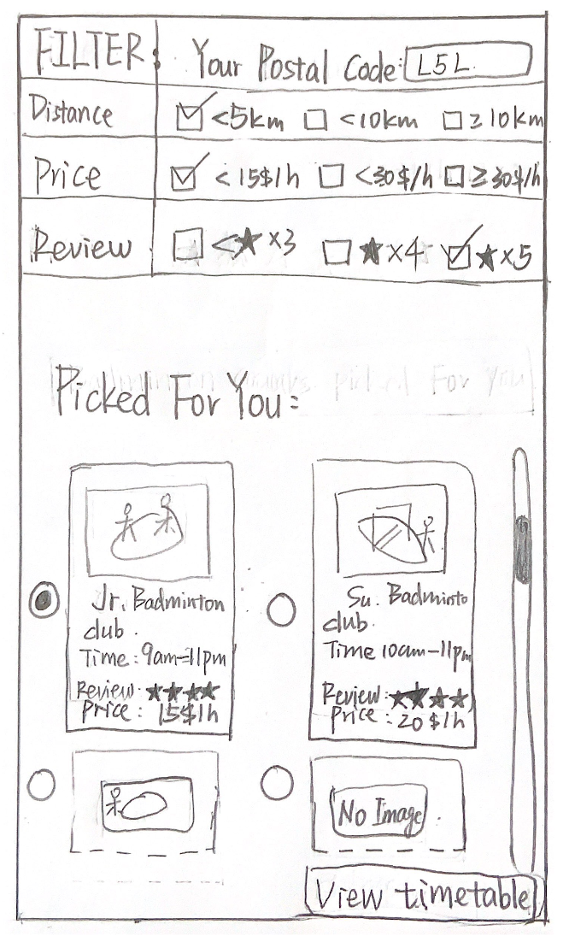
5.3 Low-Fidelity Paper Prototype
1. You plan to play badminton with your friends on June 30th, so you want to find a cost-effective badminton court near your living place first, how can you do to find the court using this prototype?
EXPECTED USER ACTION
Type [Postal code]
Check the [Distance (Optional)]
Check the [Price (Optional)]
Check the [Review (Optional)]
Click with one of the badminton courts
Click [View timetable]
OBSERVED ACTION
USER QUOTES
DESIGN IMPLICATIONS for A5b Results

Slide 7
5.3 Low-Fidelity Paper Prototype
You are a new user to the app, how can create your account through this prototype?
EXPECTED USER ACTION
Click [SIGN UP]
OBSERVED ACTION
USER QUOTES
DESIGN IMPLICATIONS for A5b Results

Slide 8
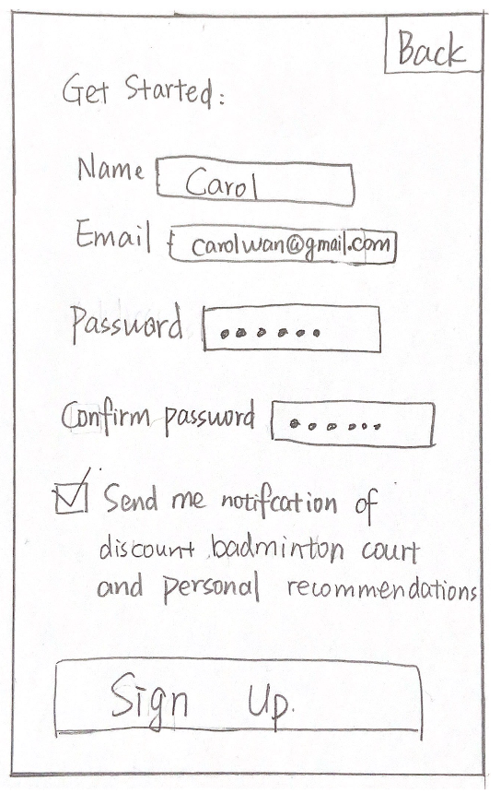
5.3 Low-Fidelity Paper Prototype
You are a new user to the app, how can create your account?
EXPECTED USER ACTION
Type [Name]
Type [Email]
Type [Password]
Type [Confirm Password]
Check [Notification (optional)]
Click [Sign Up]
OBSERVED ACTION
USER QUOTES
DESIGN IMPLICATIONS for A5b Results

Slide 9
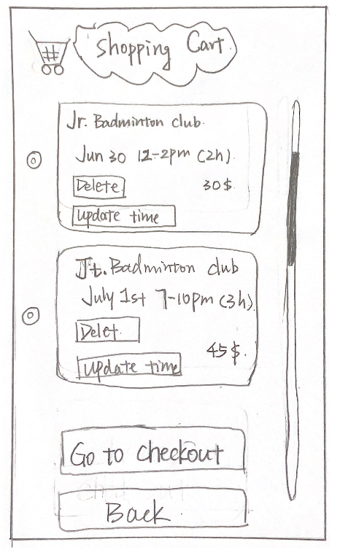
5.3 Low-Fidelity Paper Prototype
3. You just remembered that you have a midterm coming up on July 1st, you will need to prepare for the midterm instead of playing badminton. How can you cancel the plan or change the time slots from the shopping cart?
4. You are satisfied with the plans in the shopping cart and want to make a payment to hold the space, what can you do with this prototype?
EXPECTED USER ACTION
Click [Delete]
Click [Update time]
Click [Go to checkout]
OBSERVED ACTION
USER QUOTES
DESIGN IMPLICATIONS for A5b Results

Slide 10
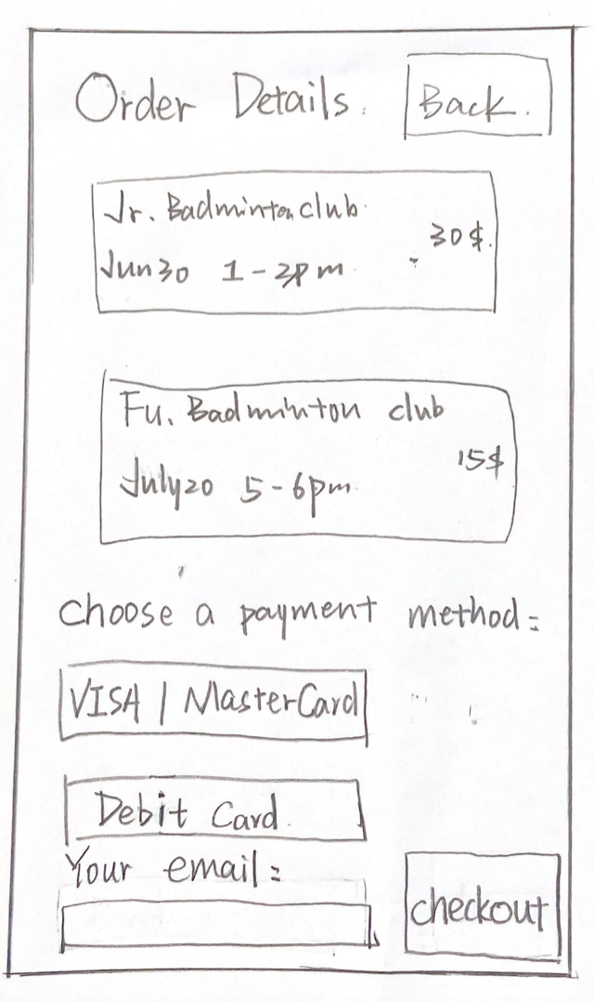
5.3 Low-Fidelity Paper Prototype
4. You are satisfied with the plans in the shopping cart and want to make a payment to hold the space, what can you do with this prototype?
EXPECTED USER ACTION
Click [VISA/MasterCard or Debit card]
Type [email]
Click [checkout]
OBSERVED ACTION
USER QUOTES
DESIGN IMPLICATIONS for A5b Results

